Slide 1

Reinforcement Learning for Active Learning
Interdisciplinary Project
Ming Yip, Cheung

Slide 2

Content
What is Active Learning ?
What is Reinforcement Learning ?
Related Work
Formulate Active Learning as a Reinforcement Learning problem
Full Algorithm
Challenges
Result
Conclusion

Slide 3

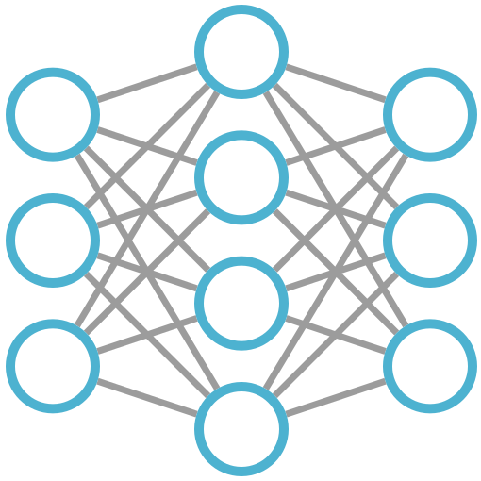
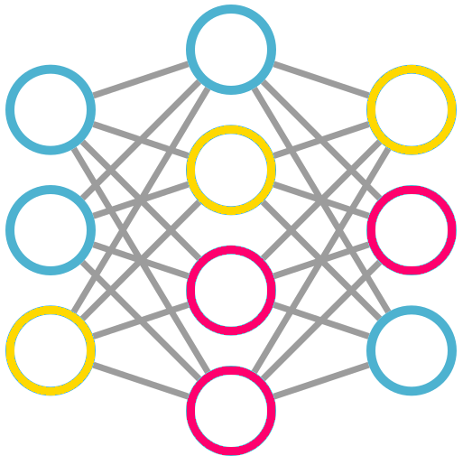
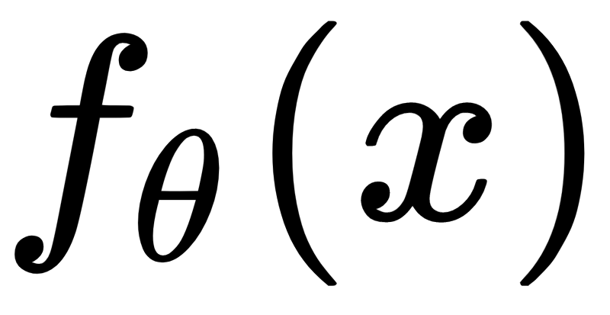
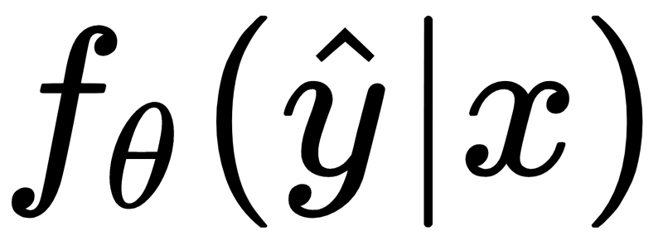

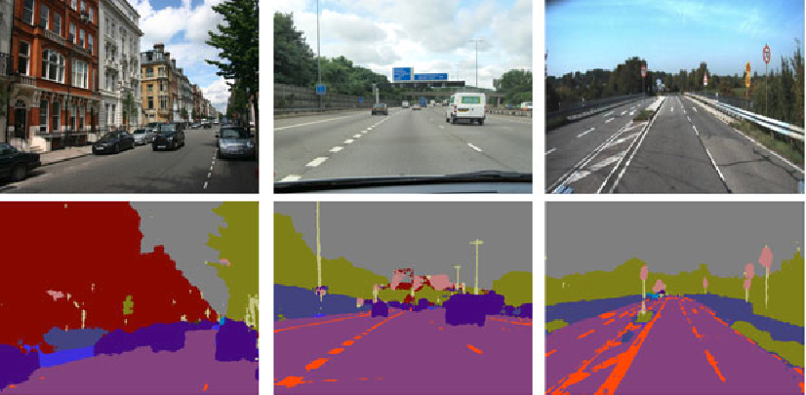
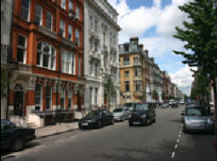
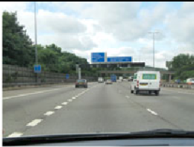
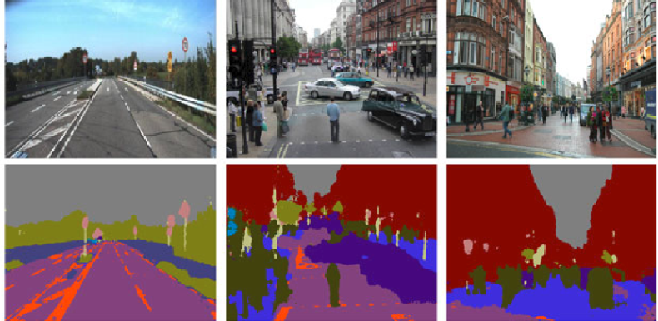
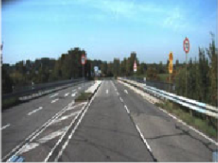
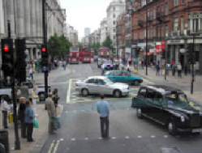
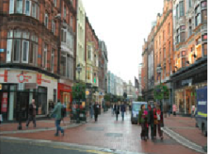
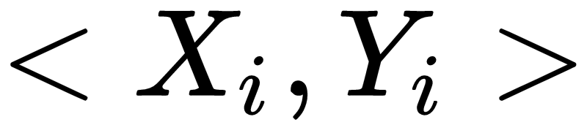
Active Learning
Training
Uncertainty estimates
Model
Prediction
Human annotator
Database
[1]
Labelled sampled (10%)
Unlabeled sampled (90%)
Labelling
[1] Badrinarayanan, V., Kendall, A., & Cipolla, R. (2015). SegNet: A Deep Convolutional Encoder-Decoder Architecture for
Image Segmentation. IEEE Transactions on Pattern Analysis and Machine Intelligence, 39, 2481-2495.

Slide 4
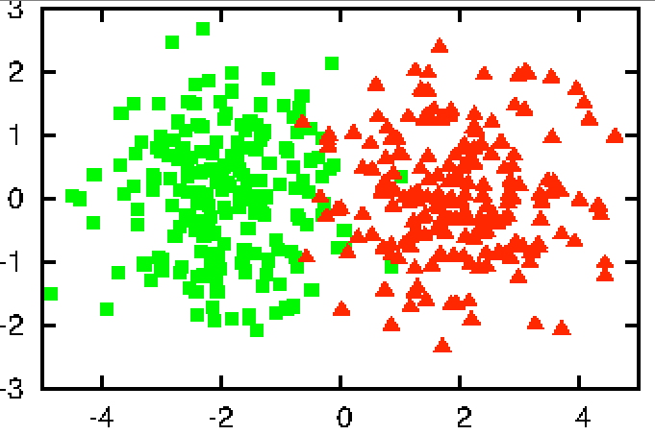



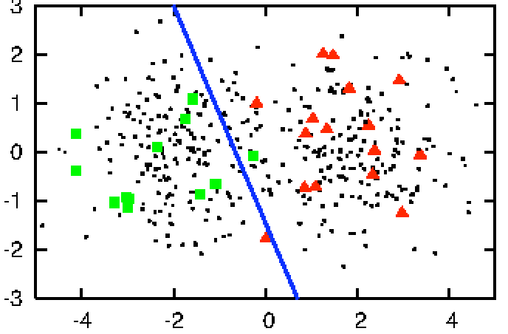
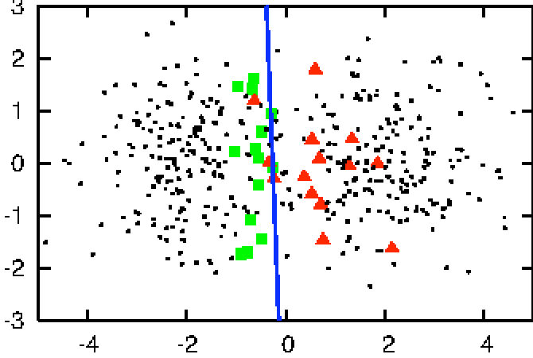

Active Learning
400 instances data from 2 classes
Advantages:
Requires less training data
Label efficient learning strategy
Handle skewed dataset better
Faster convergence
[3]
[2]
Random sampling
30 data (70% acc)
Uncertainty sampling
30 data (90% acc)
[2] Settles, B. (2009). Active Learning Literature Survey.
[3] Slotkin, M. (2019, September 30). Accelerate Machine Learning with Active Learning. Retrieved from
https://becominghuman.ai/accelerate-machine-learning-with-active-learning-96cea4b72fdb.

Slide 5
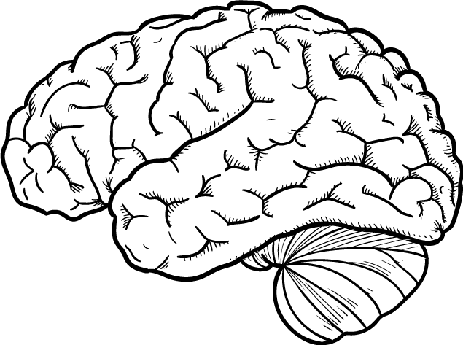



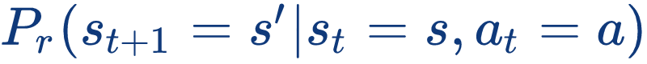
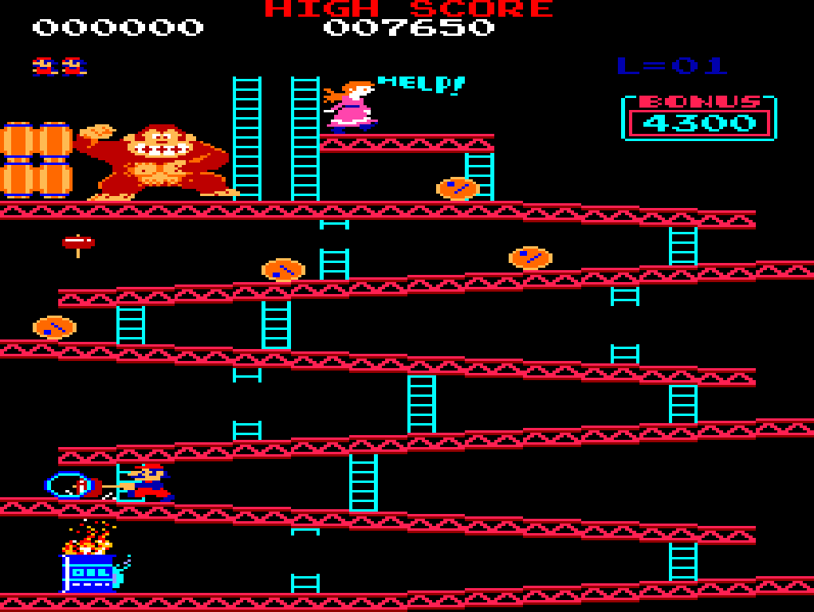
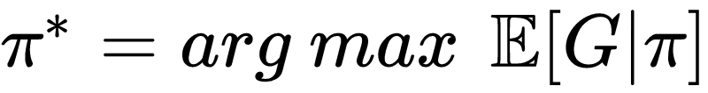

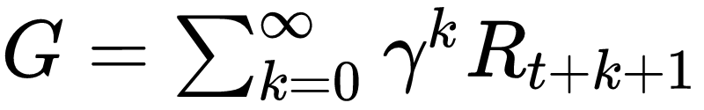
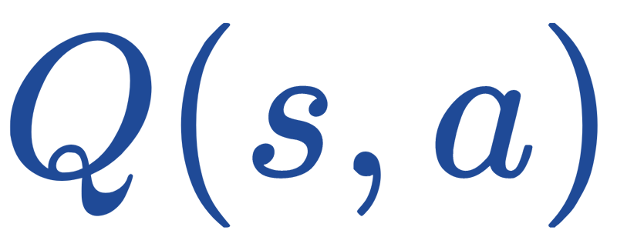
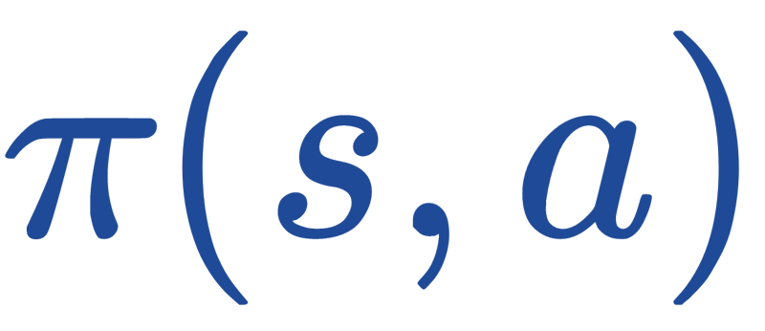
Reinforcement Learning
[4]
Modeled as a Markov decision process
A set of states
A set of actions
Reward function
Probabilistic transition function
Goal: maximize the total expected future reward
[5]
Agent
State
Action
Reward
where
In a Value-based method, we learn and predict the value.
In a Policy gradient method , we learn policy .
Environment
[6]
[4] Sutton, R.S., & Barto, A.G. (1988). Reinforcement Learning: An Introduction. IEEE Transactions
on Neural Networks, 16, 285-286.
[5] Richard Bellman. A markovian decision process.Indiana Univ. Math. J., 6:679–684,1957
[6] Sutton, R.S., McAllester, D.A., Singh, S.P., & Mansour, Y. (1999). Policy Gradient Methods for
Reinforcement Learning with Function Approximation. NIPS.

Slide 6

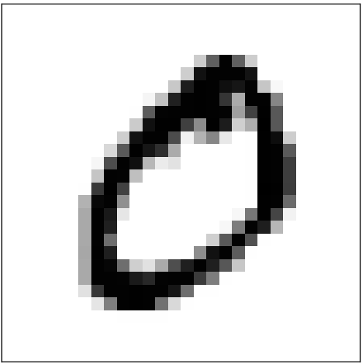
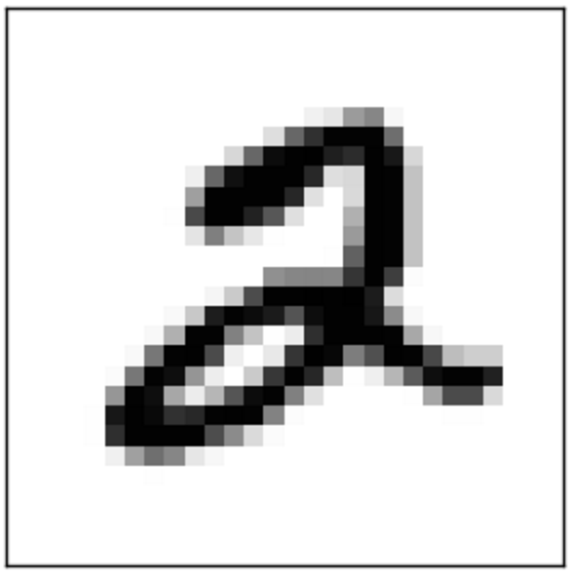



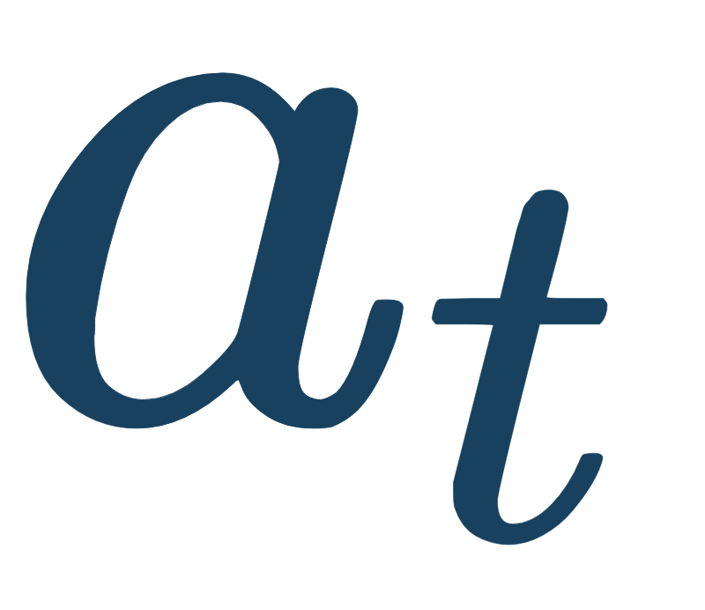
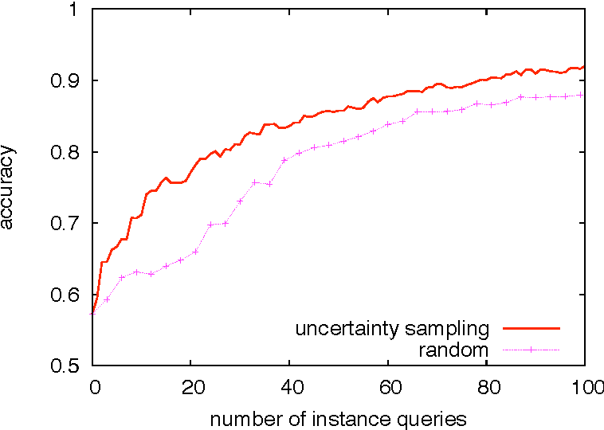

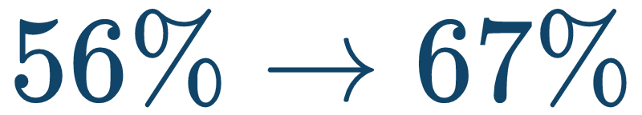
Reinforcement Learning for Active Learning
State
Objective
Combine RL with AL for classification
Stream-based active learning
Neural network as environment
Agent
Action
State | images, network weights
Action | select or discard images
Reward | accuracy
Environment
Reward

Slide 7
Related Work

Slide 8

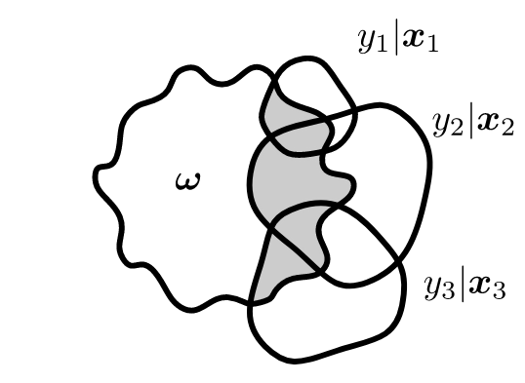
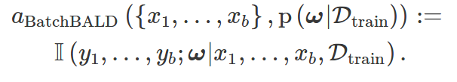
Related Work
Active Learning Methods:
Uncertainty sampling
Query-By-Committee
Variance reduction
Deep Active Learning:
Studies of AL approaches for neural network
Uncertainty-based method
Bayesian uncertainty measure
Reinforcement Learning for:
Transfer learning
Named entity recognition (NER)
Auto data augmentation
[7] [8]
[13]
[9]
[14]
[10]
[15]
[11]
[12]
[7] David D. Lewis and William A. Gale. A sequential algorithm for training text classifiers. In SIGIR, 1994
[8] David D. Lewis and Jason Catlett. Heterogeneous uncertainty sampling for supervised learning. In ICML, 1994
[9] H. Sebastian Seung, Manfred Opper, and Haim Sompolinsky. Query by committee.In COLT, 1992
[10] Nicholas D Roy and D. Archibald Mccallum. Toward optimal active learning through monte carlo estimation of error reduction. In ICML
2001, 2001.
[11] Keze Wang, Dongyu Zhang, Ya Li, Ruimao Zhang, and Liang Lin. Cost-effective active learning for deep image classification. IEEE
Transactions on Circuits and Systems for Video Technology, 2016.
[12] Yarin Gal, Riashat Islam, and Zoubin Ghahramani. Deep bayesian active learning with image data. arXiv preprint arXiv:1703.02910, 2017.
[13] Meng Fang, Yuan Li, and Trevor Cohn. Learning how to active learn: A deep reinforcement learning approach. In EMNLP, 2017
[14] Yanyao Shen, Hyokun Yun, Zachary Chase Lipton, Yakov Kronrod, and Anima Anandkumar. Deep active learning for named entity
recognition. In ICLR, 2017.
[15] Ekin Dogus Cubuk, Barret Zoph, Dandelion Man ́e, V. Vasudevan, and Quoc V. Le.Autoaugment: Learning augmentation strategies from
data. In CVPR, 2019

Slide 9
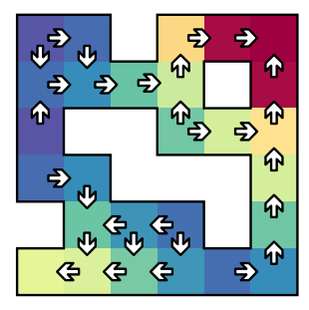
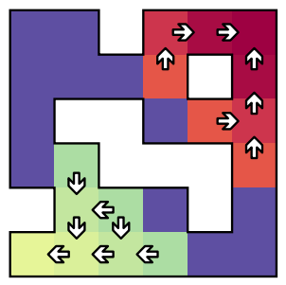
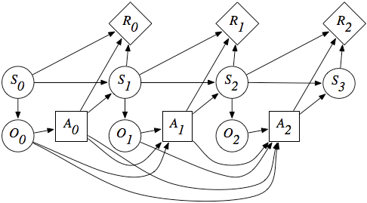
Related Work
Time Limits in Reinforcement Learning [16]
Time limits are part of the state of the environment
Include the remaining time as part of the state
significant performance improvements for agents with time-awareness
Partially observable Markov decision process: [17]
Partially Observable Environments
Deal with the uncertainty of states
Beliefs of environment states:
(a) Standard
(b) Time-awareness
[16] Pardo, F., Tavakoli, A., Levdik, V., & Kormushev, P. (2017). Time Limits in Reinforcement Learning. ICML.
[17] Åström, K.J. (1965). "Optimal control of Markov processes with incomplete state information".Journal of
Mathematical Analysis and Applications. 10: 174–205

Slide 10
Algorithm

Slide 11
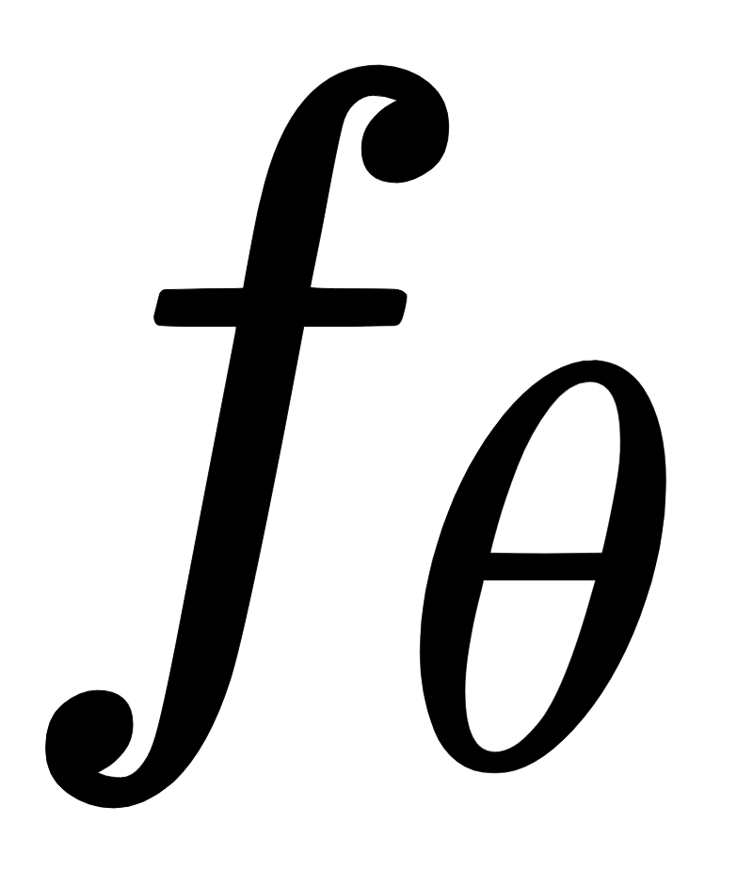
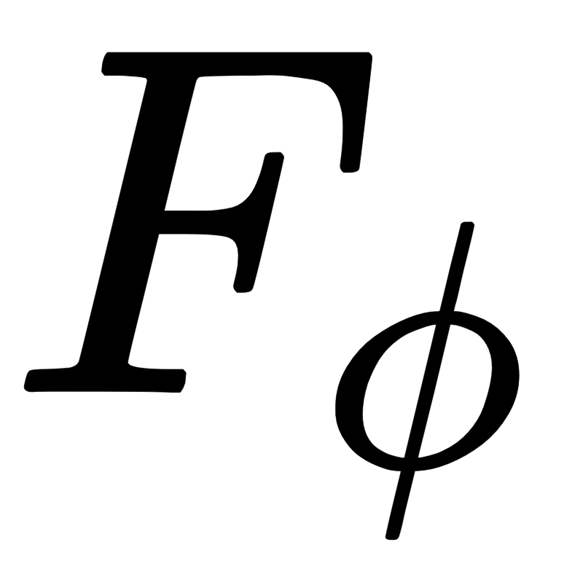
1 Training iteration - step by step
Classification Network
RL Agent

Slide 12

1 Training iteration - step by step
3
Classification Network
RL Agent
100 images
1
Select 100 random images

Slide 13

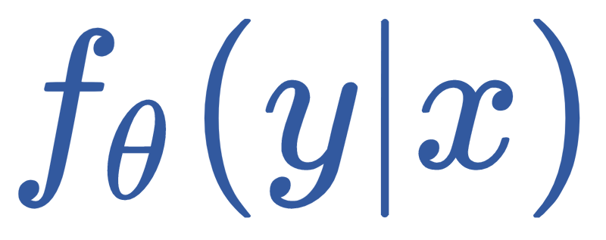
1 Training iteration - step by step
Classification Network
RL Agent
2
State S: Output Probability
100 images
1
Select 100 random images

Slide 14

1 Training iteration - step by step
Predict the state value
3
Classification Network
13.2
15.8
10.7
RL Agent
2
State S: Output Probability
100 images
1
Select 100 random images

Slide 15
1 Training iteration - step by step
Action a: Select 10 images
with highest prediction value
Predict the state value
4
3
Classification Network
13.2
15.8
10.7
RL Agent
2
State S: Output Probability
100 images
1
Select 100 random images

Slide 16
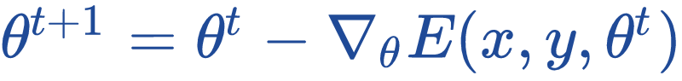
1 Training iteration - step by step
Action a: Select 10 images
with highest prediction value
Predict the state value
5
Train the network with the image batch for 50 epochs
4
3
Classification Network
13.2
15.8
10.7
RL Agent
2
State S: Output Probability
100 images
1
Select 100 random images

Slide 17
1 Training iteration - step by step
Action a: Select 10 images
with highest prediction value
Predict the state value
5
Train the network with the image batch for 50 epochs
4
3
Classification Network
13.2
15.8
10.7
RL Agent
2
State S: Output Probability
100 images
6
New State S’
Reward: Accuracy
We evaluate the CNN with Validation set
and get the accuracy as Reward
1
Select 100 random images

Slide 18
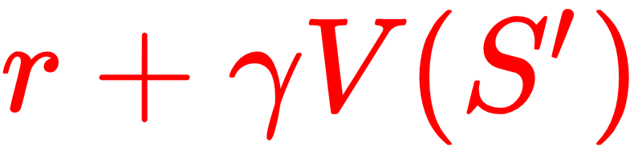
1 Training iteration - step by step
Action a: Select 10 images
with highest prediction value
Predict the state value
5
Train the network with the image batch for 50 epochs
4
3
Classification Network
13.2
15.8
10.7
RL Agent
2
State S: Output Probability
Train RL agent with
7
100 images
6
New State S’
Reward: Accuracy
We evaluate the CNN with Validation set
and get the accuracy as Reward
TD - Target
1
Select 100 random images

Slide 19
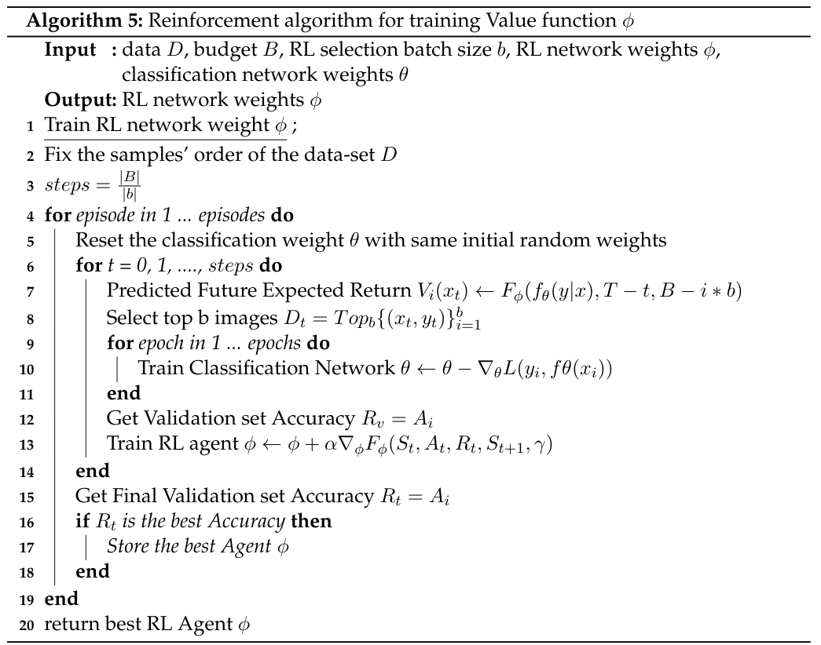
Algorithm
Train CNN
Train RL Agent

Slide 20
Algorithm
Time awareness
Remaining episodes (RL)
Remaining budgets (CNN)
[16]
Train CNN
Train RL Agent
[16] Pardo, F., Tavakoli, A., Levdik, V., & Kormushev, P. (2017). Time Limits in Reinforcement Learning. ICML.

Slide 21
Challenges
Split a complete state into a batch
Evaluate the importanceness of each image
Incomplete information of the state
The RL agent observes only part of the state
We select the top k images from a batch with M images
If (M, k) are too large then the RL agent can hardly learn anything.
If (M, k) are too small then the CNN network learns too slow and
with insignificant reward
Markov Decision Process assumption
Naive approach is a stateless environment
Randomly select images from the date-set
Each state does not necessary depend on the previous state
Need to include the information of the CNN network weight
The output probability may keep the MDP assumption
Predict the state value
13.2
15.8
10.7

Slide 22

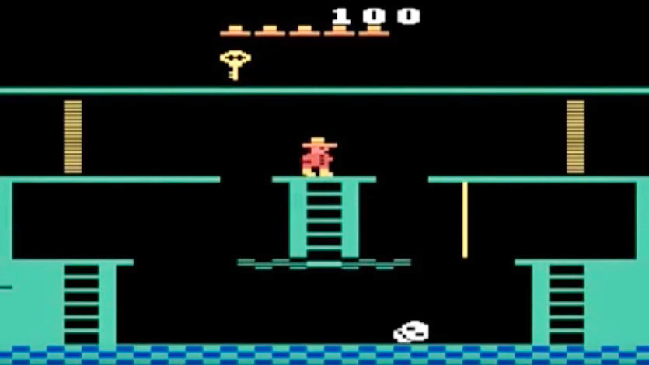
Challenges
Split a complete state into a batch
Evaluate the importanceness of each image
Incomplete information of the state
The RL agent observes only part of the state
We select the top k images from a batch with M images
If (M, k) are too large then the RL agent can hardly learn anything.
If (M, k) are too small then the CNN network learns too slow and
with insignificant reward
Markov Decision Process assumption
Naive approach is a stateless environment
Randomly select images from the date-set
Each state does not necessary depend on the previous state
Need to include the information of the CNN network weight
The output probability may keep the MDP assumption
Top k
V(s)

Slide 23
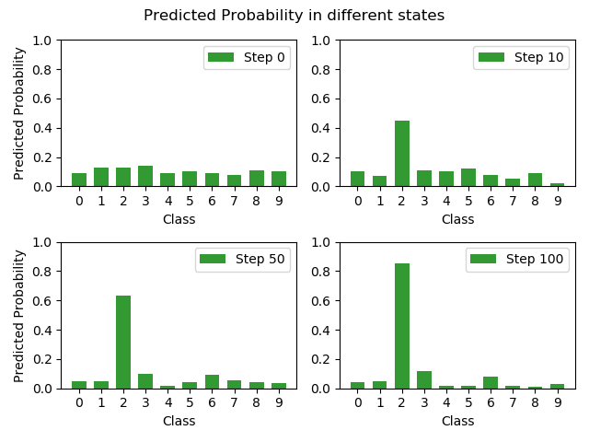
Challenges
Split a complete state into a batch
Evaluate the importanceness of each image
Incomplete information of the state
The RL agent observes only part of the state
We select the top k images from a batch with M images
If (M, k) are too large then the RL agent can hardly learn anything.
If (M, k) are too small then the CNN network learns too slow and
with insignificant reward
Markov Decision Process assumption
Naive approach is a stateless environment
Randomly select images from the date-set
Each state does not necessary depend on the previous state
Need to include the information of the CNN network weight
The output probability may keep the MDP assumption

Slide 24
Evaluation

Slide 25
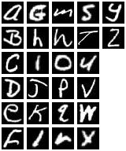
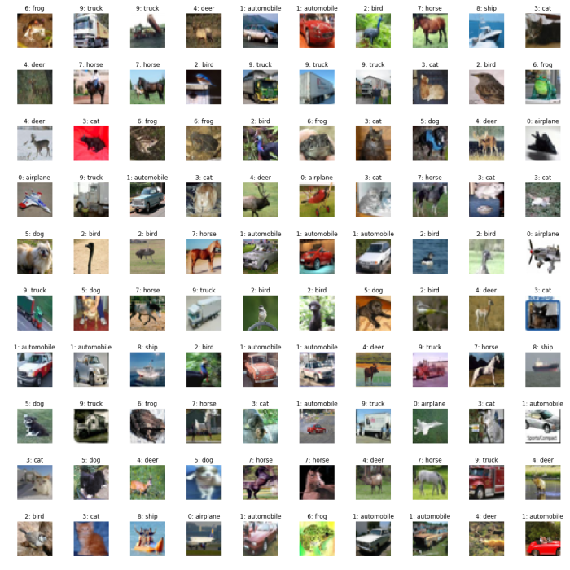
Data sets
Data sets | Num. of Images | Num. of Classes | Num. of Training images | Num. of Validation images | Num. of Test images | Num. of images per class | Dimension
MNIST [18] | 70,000 | 10 | 50,000 | 10,000 | 10,000 | ~7,000 | 28x28
CIFAR-10 [19] | 60,000 | 10 | 48,000 | 6,000 | 6,000 | ~6,000 | 32x32x3
EMNIST [20] | 78,000 | 26 | 62,400 | 7,800 | 7,800 | 3,000 | 28x28
Table1: 3 labeled datasets
Random Agent
vs
Least Margin Sampling Method (BVSB):
MNIST
CIFAR-10
EMNIST
[18] Yann LeCun, Corinna Cortes, and CJ Burges. Mnist handwritten digit database.ATTLabs [Online]. Available: http://yann. lecun. com/exdb/mnist, 2, 2010.
[19] Alex Krizhevsky. Learning multiple layers of features from tiny images. Technical report, 2009.
[20] Gregory Cohen, Saeed Afshar, Jonathan Tapson, and Andre Van Schaik. Emnist: Ex-tending mnist to handwritten letters.2017 International Joint Conference on Neural Networks (IJCNN), 2017.

Slide 26
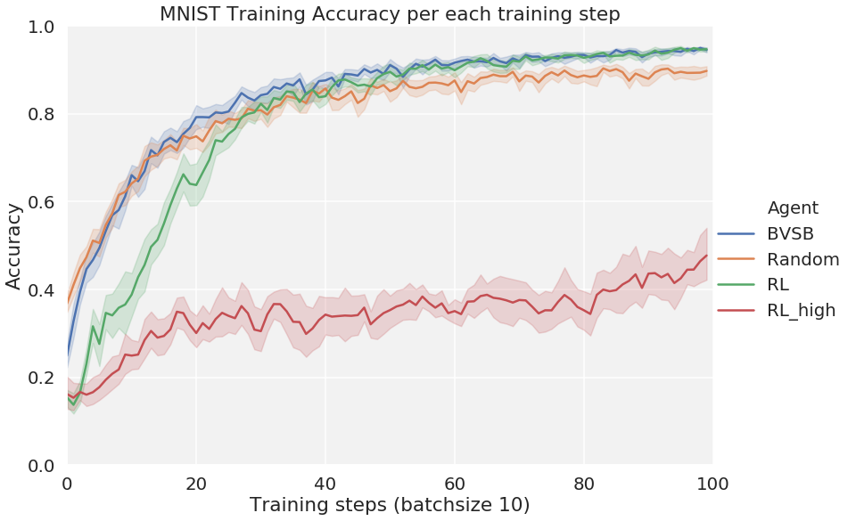
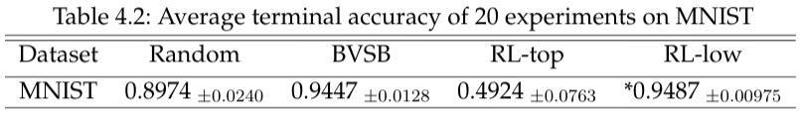
MNIST

Slide 27
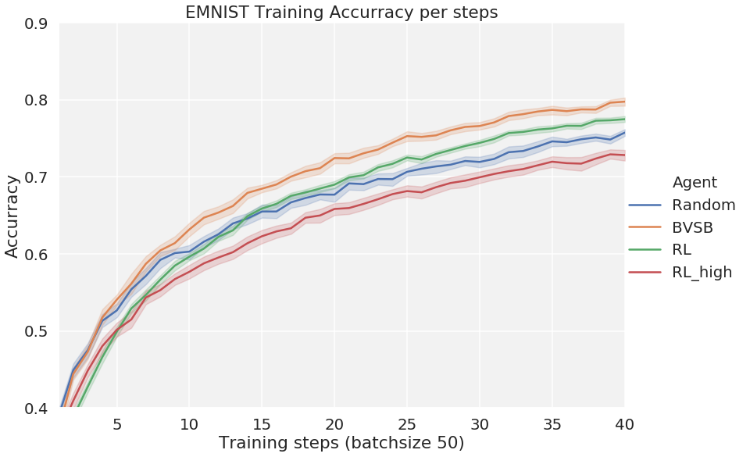
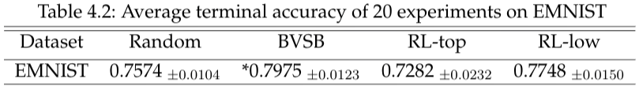
EMNIST

Slide 28
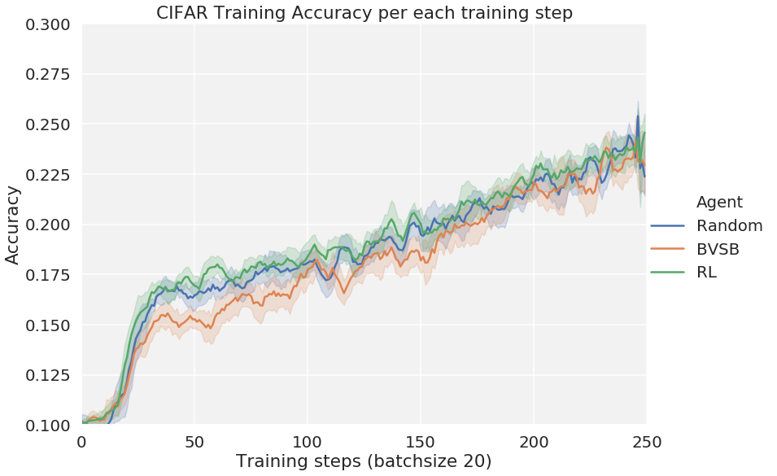
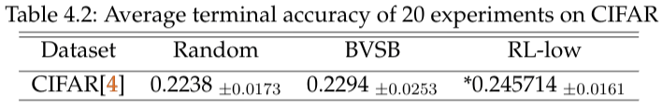
CIFAR

Slide 29
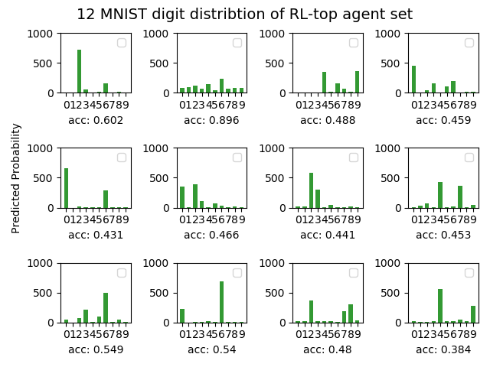
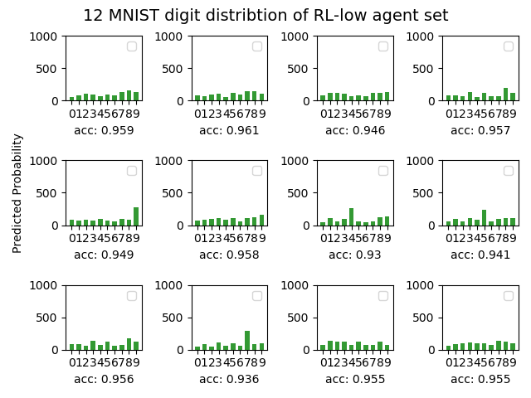
Selection bias

Slide 30

Entropy of the selection distribution
V(s)
Batch
10
9
8
7
6
5
4
3
2
1

Slide 31

Effect of using exploration rate

Slide 32
Conclusion
Competitive good result on MNIST and EMNIST
CIFAR-10
RL-top agent suffers from the bias selection
Exploitation hurts the performance

Slide 33
Thank you

Slide 34
Reference
Badrinarayanan, V., Kendall, A., & Cipolla, R. (2015). SegNet: A Deep Convolutional Encoder-Decoder Architecture for Image Segmentation. IEEE Transactions on Pattern Analysis and Machine Intelligence, 39, 2481-2495.
Settles, B. (2009). Active Learning Literature Survey
Slotkin, M. (2019, September 30). Accelerate Machine Learning with Active Learning. Retrieved from https://becominghuman.ai/accelerate-machine-learning-with-active-learning-96cea4b72fdb.
Sutton, R.S., & Barto, A.G. (1988). Reinforcement Learning: An Introduction. IEEE Transactions on Neural Networks, 16, 285-286.
Richard Bellman. A markovian decision process.Indiana Univ. Math. J., 6:679–684,1957
Sutton, R.S., McAllester, D.A., Singh, S.P., & Mansour, Y. (1999). Policy Gradient Methods for Reinforcement Learning with Function Approximation. NIPS.
David D. Lewis and William A. Gale. A sequential algorithm for training text classifiers. InSIGIR, 1994
David D. Lewis and Jason Catlett. Heterogeneous uncertainty sampling for supervised learning. In ICML, 1994
H. Sebastian Seung, Manfred Opper, and Haim Sompolinsky. Query by committee.In COLT, 1992
Nicholas D Roy and D. Archibald Mccallum. Toward optimal active learning through monte carlo estimation of error reduction. In ICML 2001, 2001.
Keze Wang, Dongyu Zhang, Ya Li, Ruimao Zhang, and Liang Lin. Cost-effective active learning for deep image classification. IEEE Transactions on Circuits and Systems for Video Technology, 2016.
Yarin Gal, Riashat Islam, and Zoubin Ghahramani. Deep bayesian active learning with image data. arXiv preprint arXiv:1703.02910, 2017.
Meng Fang, Yuan Li, and Trevor Cohn. Learning how to active learn: A deep reinforcement learning approach. In EMNLP, 2017
Yanyao Shen, Hyokun Yun, Zachary Chase Lipton, Yakov Kronrod, and Anima Anandkumar. Deep active learning for named entity recognition. In ICLR, 2017.
Ekin Dogus Cubuk, Barret Zoph, Dandelion Man ́e, V. Vasudevan, and Quoc V. Le.Autoaugment: Learning augmentation strategies from data. In CVPR, 2019

Slide 35
Reference
Pardo, F., Tavakoli, A., Levdik, V., & Kormushev, P. (2017). Time Limits in Reinforcement Learning. ICML.
Åström, K.J. (1965). "Optimal control of Markov processes with incomplete state information".Journal of Mathematical Analysis and Applications. 10: 174–205
Yann LeCun, Corinna Cortes, and CJ Burges. Mnist handwritten digit database.ATTLabs [Online].
Available: http://yann.lecun.com/exdb/mnist, 2, 2010.
Alex Krizhevsky. Learning multiple layers of features from tiny images. Technical report, 2009.
Gregory Cohen, Saeed Afshar, Jonathan Tapson, and Andre Van Schaik. Emnist: Ex-tending mnist to handwritten letters.2017 International Joint Conference on Neural Networks (IJCNN), 2017.

